Slide 1
LEAF DISEASE DETECTION SYSTEM WITH PLOUGHING AND SEEDING ROBOT
GUIDED BY
PROF. ABDUL RAOUF KHALID M T
ASSISTANT PROFESSOR
ECE DEPARTMENT
GEC WAYANAD
GROUP MEMBERS
1) MAZEN HAMZA
2) AKSHAY KONOOR
3) ABDUL AKHIL PASHA
<number>

Slide 2
CONTENTS
INTRODUCTION
LITERATURE SURVEY
OBJECTIVE
PROPOSED SYSTEM
CIRCUIT DIAGRAM
HARDWARE COMPONENTS
PCB DESIGN
SOFTWARE AND LANGUAGES
TRAINING AND TESTING PHASE OF THE SYSTEM
FLOWCHART OF IMAGE PROCESSING SYSTEM
IMAGE PROCESSING STEPS
TYPES OF DISEASE
DATA SET
ACCURACY OF DETECTION
OUTPUT
PROPOSED MODEL
COST ANALYSIS
CONCLUSION
FUTURE SCOPE
REFERENCE
<number>

Slide 3
INTRODUCTION
Agricultural robotics is used for automation in bio-systems such as agriculture, forestry and fisheries.
It replaces the conventional techniques to perform the same task with efficiency.
In agriculture, the opportunities for the robot-enhanced productivity are immense.
The robots can perform the agricultural operations autonomously such as the ploughing, seed dispensing etc.
<number>

Slide 4
LITERATURE SURVEY
“ Autonomous Agri robot for smart farming” Ashish Lalwani , Mrunmai Bhide, and S. K. Shah
“ Detection and Classification of Diseases of Banana Plant Using Local Binary Pattern and Support Vector Machine .” Akshaya Aruraj; Ashish Alex; M.S.P Subathra; N.J Sairamya; S. Thomas George; S.E. Vinodh Ewards2019 International Conference on Signal Processing and Communication (ICSPC -2019), March. 29 – 30, 2019, Coimbatore,
“Intelligent Autonomous Farming Robot with Plant Disease Detection using Image Processing”D. A. Shaikh, Ghorale Akshay G, Chaudhari Prashant A, Kale Parmeshwar L. International Journal of Advanced Research in Computer and Communication Engineering Vol. 5, Issue 4, April 2016
Detection of plant disease using threshold, k-mean cluster and ann algorithm”. Tete, T. N., & Kamlu, S. (2017). 2017 2nd International Conference for Convergence in Technology (I2CT). doi:10.1109/i2ct.2017.8226184
“An overview of the research on plant leaves disease detection using image processing techniques.” Gavhale KR, Gawande U.IOSR Journal of Computer Engineering (IOSR- JCE).
<number>

Slide 5
Paper 1
“ Autonomous Agri robot for smart farming” Ashish Lalwani , Mrunmai Bhide, and S. K. Shah
A manual switch is used to control the robotic actions like NPK measurement, seeding, fertilizer spray, harvesting of fruits.
When the power supply is turned on, the robot will be in idle mode until manual switch is used.
The robot can start performing the task and at the same time it can detect obstacles in the path of robot using IR sensors.
Distance calculated is not accurate.
<number>

Slide 6
Paper 2
“ Detection and Classification of Diseases of Banana Plant Using Local Binary Pattern and Support Vector Machine .” Akshaya Aruraj; Ashish Alex; M.S.P Subathra; N.J Sairamya; S. Thomas George; S.E. Vinodh Ewards2019 International Conference on Signal Processing and Communication (ICSPC -2019), March. 29 – 30, 2019, Coimbatore,
The approach included texture analysis of banana leaf images using LBP
The algorithm is applied on RGB images with .jpeg and .png format.
The preprocessing step includes the conversion of input images into grey scale images and the texture analyses done using LBP.
The LBP histogram features for healthy, diseased leaves are determined
<number>

Slide 7
Paper 3
“Intelligent Autonomous Farming Robot with Plant Disease Detection using Image Processing”D. A. Shaikh, Ghorale Akshay G, Chaudhari Prashant A, Kale Parmeshwar L. International Journal of Advanced Research in Computer and Communication Engineering Vol. 5, Issue 4, April 2016
In this paper, an Agricultural robot is used to move around the field. It captures the image of the leaf and perform the disease detection operations.
Here a camera is placed on a robotic car that captures the images which is transferred to the system wirelessly using RF module.
In this system, the captured image process on MATLAB for detection of the disease
Open CV is more efficient compared to MATLAB
<number>

Slide 8
Paper 4
“ Detection of plant disease using threshold, k-mean cluster and ANN algorithm”. Tete, T. N., & Kamlu, S. (2017). 2017 2nd International Conference for Convergence in Technology (I2CT). doi:10.1109/i2ct.2017.8226184
In this paper ANN algorithm are used for detection of plant disease
Accuracy of ANN algorithm is 85%
SVM algorithm is more accurate compared to ANN
Accuracy of SVM is 91%
<number>

Slide 9
Paper 5
“An overview of the research on plant leaves disease detection using image processing techniques.” Gavhale KR, Gawande U.IOSR Journal of Computer Engineering (IOSR- JCE).
In this paper, the image processing used for the identification of leaf diseases is SVM.
There are five steps for leaf disease identification which are image acquisition, image pre-processing, segmentation, feature extraction and classification.
By using this technique, the disease identification is done for all kinds of leaves and also the user can know the affected area of leaf in percentage by identifying the disease properly.
User can rectify the problem very easily with low cost.
<number>

Slide 10
OBJECTIVES
To increase precision and efficiency
To complete a large amount of work in less time
Reduce labour cost
<number>

Slide 11
The entire system is divided into two parts
1) Ploughing and seeding robot
To plough and disperse seed in a plantation
2) Leaf disease detection system
To detect leaf disease of plant by image processing
<number>

Slide 12
PROPOSED SYSTEM
Power supply
Motor
driver
Motor 1
Start button
Motor 2
Pi Camera
Raspberry Pi
Motor
driver
Propeller
motor
Servo motor
LED Indications
Fig: Block diagram of proposed system
<number>

Slide 13
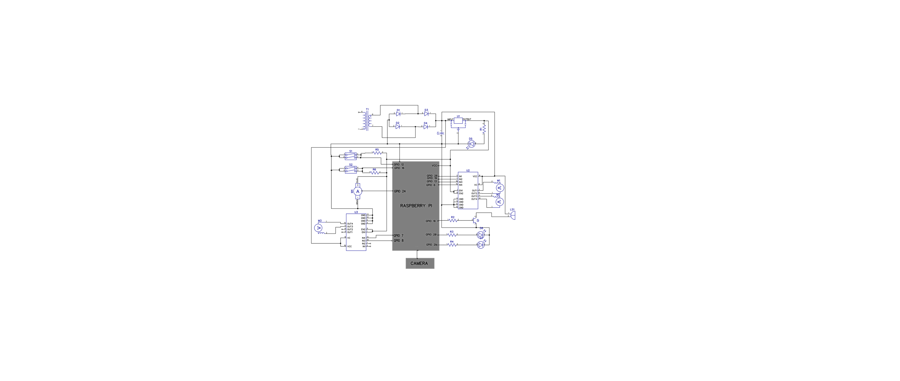
CIRCUIT DIAGRAM
Fig: Circuit Diagram of System
<number>

Slide 14
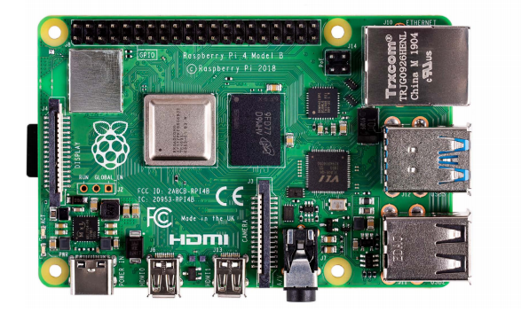
HARDWARE COMPONENTS
RASPBERRY PI -4
CPU :Broadcom BCM2711, Quad-core Cortex-A72 (ARM v8) 64-bit SoC @ 1.5GHz
RAM :1GB, 2GB, or 4GB LPDDR4-3200 SDRAM
CONNECTIVITY:
2.4GHz and 5.0GHz IEEE 802.11ac wireless, Bluetooth 5.0
2 × USB 3.0 ports; 2 × USB 2.0 ports.
2 × micro-HDMI ports
Gigabit Ethernet over USB 2.0 (maximum throughput 300Mbps)
<number>

Slide 15
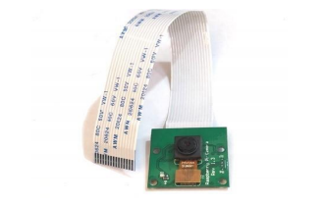
PI CAMERA
5MP color camera module without microphone for Raspberry Pi
Supports both Raspberry Pi Model A and Model B
Resolution: 2592 * 1944.
Supports: 1080p, 720p and 480p
Light weight and portable (3g only)
<number>

Slide 16
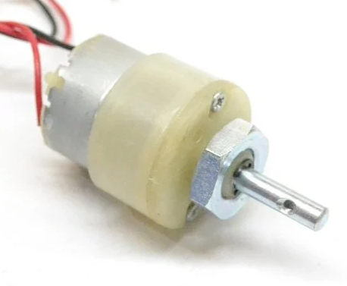
DC MOTOR
Operating Voltage: 12V
RPM: 100 RPM at 12 V
Weight:130 g
Maximum torque : 3 kg-cm at 12V
Maximum load current : 330mA at 12V
<number>

Slide 17
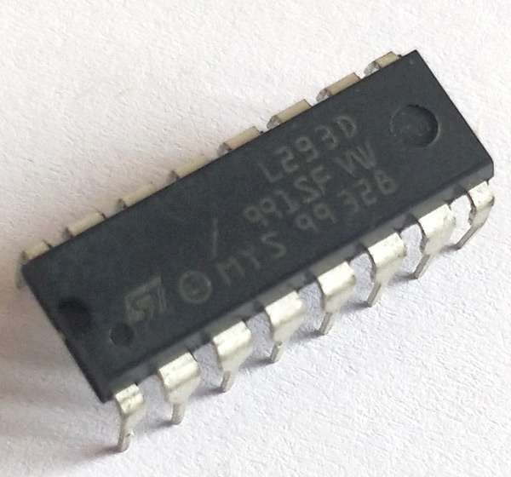
L293D MOTOR DRIVER
Used to run Two DC motors with the same IC
Wide Supply-Voltage Range: 4.5 V to 36 V.
Separate Input-Logic Supply
Operation Temperature 0°C to 70°C
Available in 16-pin DIP, TSSOP, SOIC packages
Speed and Direction control is possible
<number>

Slide 18
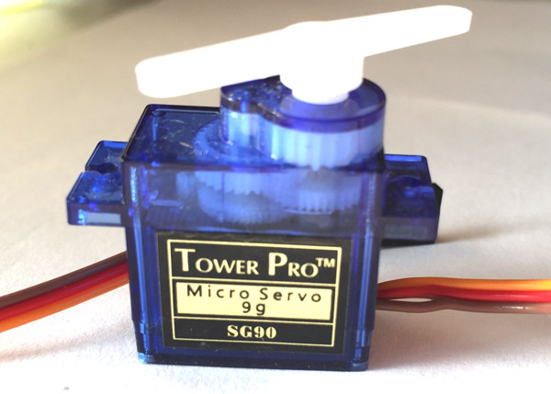
SERVO MOTOR
Operating Voltage is +5V typically
Torque: 2.5kg/cm
Operating speed is 0.1s/60°
Gear Type: Plastic
Rotation : 0°-180°
Weight of motor : 9gm
<number>

Slide 19
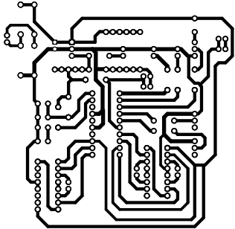
PCB DESIGN
Fig: PCB Design of System
<number>

Slide 20



SOFTWARE AND LANGUAGES
<number>

Slide 21
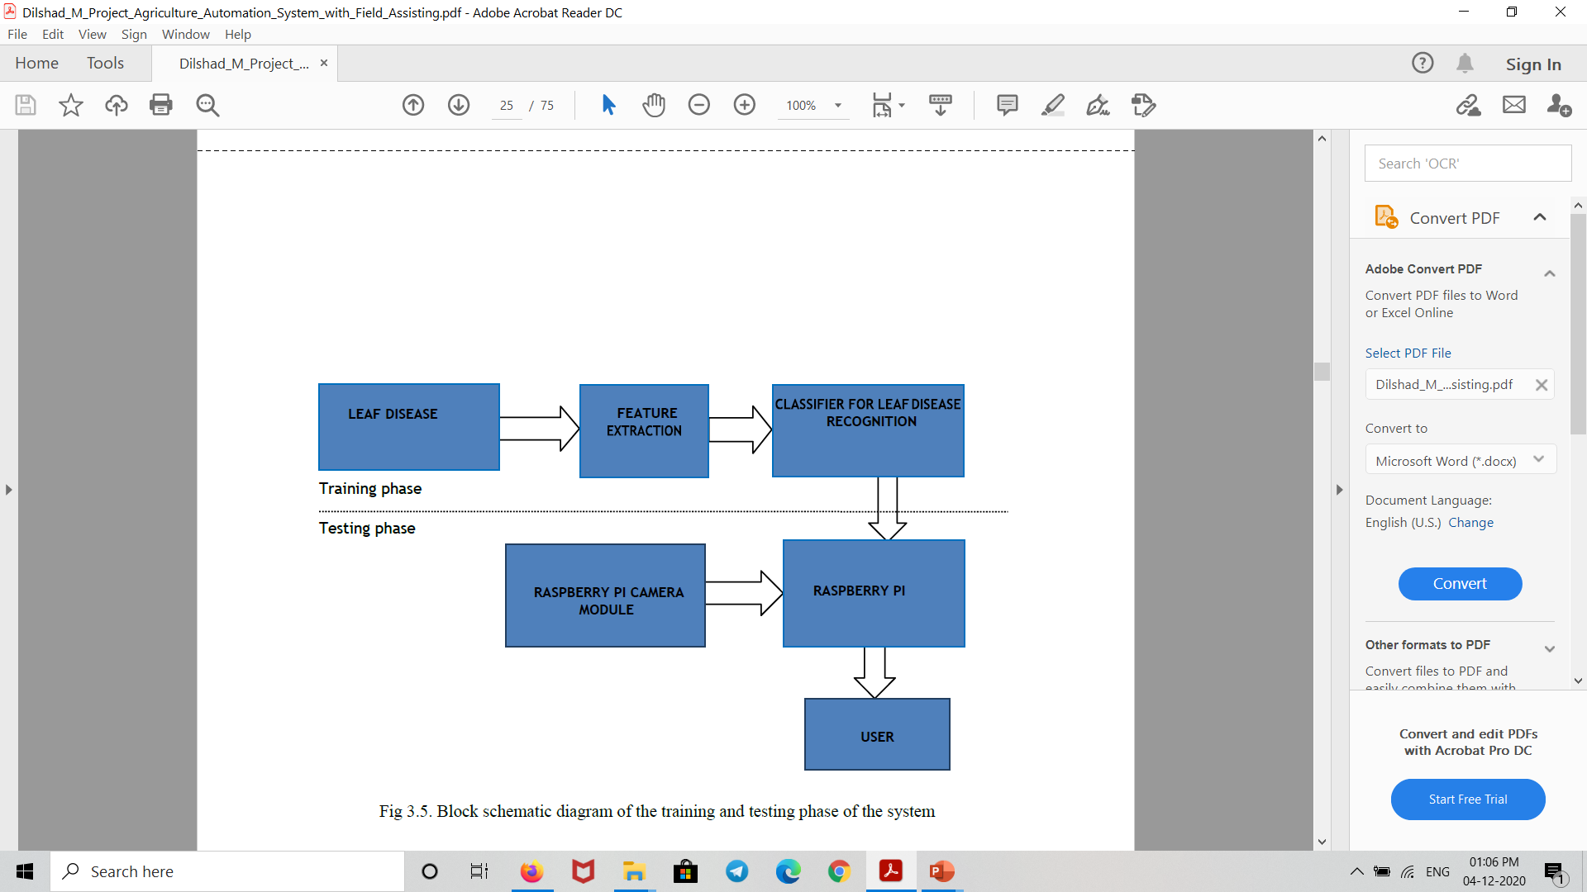
TRAINING AND TESTING PHASE OF THE SYSTEM
Fig: Block schematic diagram of the training and testing phase of the system
<number>

Slide 22
FLOWCHART OF IMAGE PROCESSING SYSTEM
Start
Send command to start camera
Is capturing done?
N
Y
Image processing
Is work done?
N
Y
Show disease name
End
<number>

Slide 23
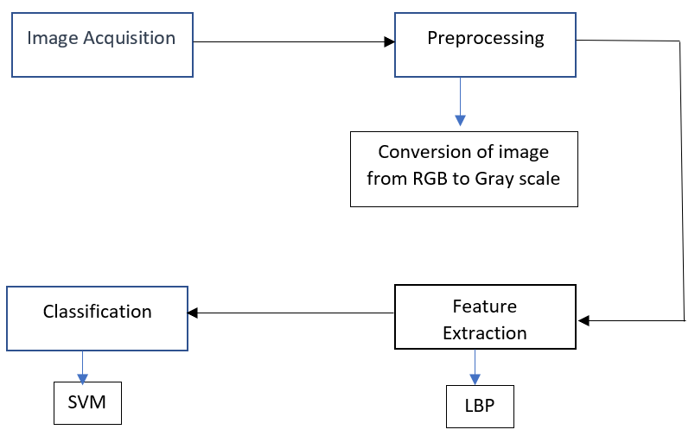
IMAGE PROCESSING STEPS
<number>

Slide 24
TYPES OF DISEASE
Cassava Bacterial blight
Mosaic disease
Brown leaf spot
<number>

Slide 25
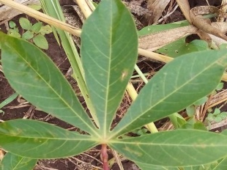
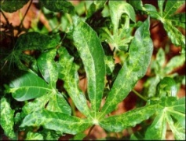
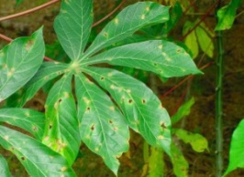
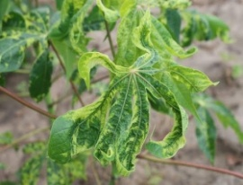
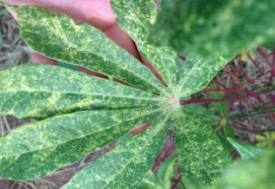
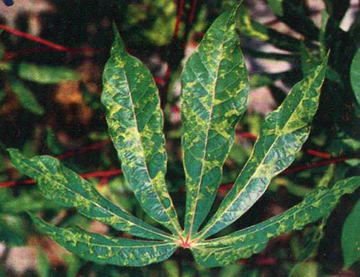
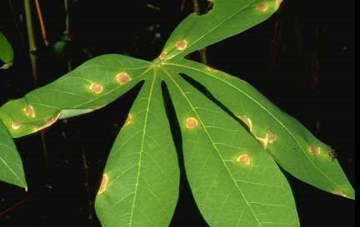
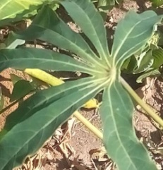
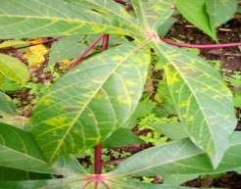
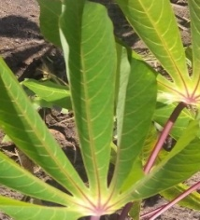
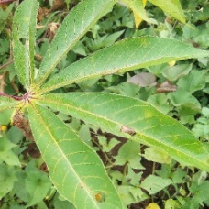
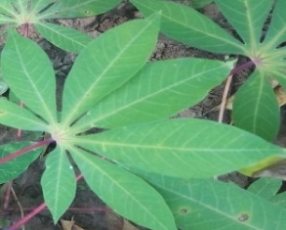
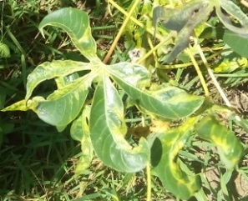
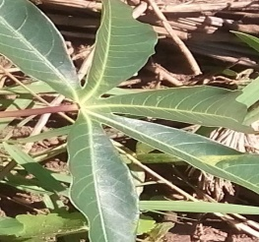
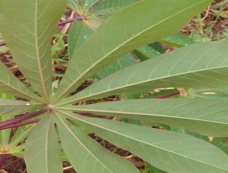
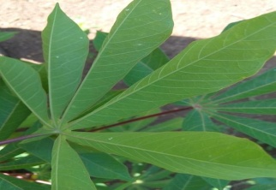
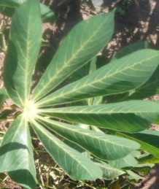
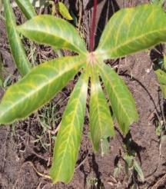
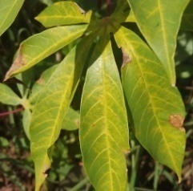
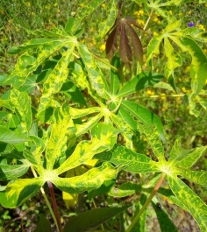
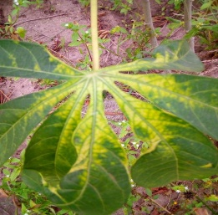
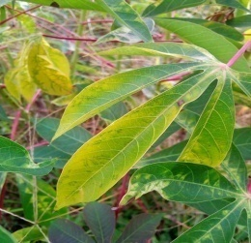
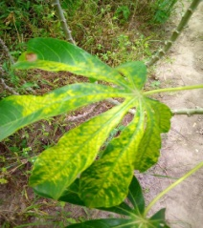
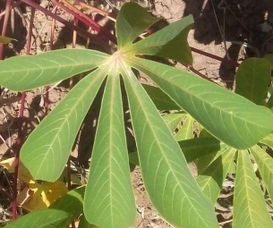
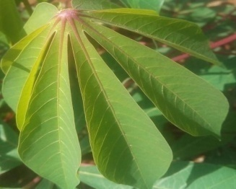
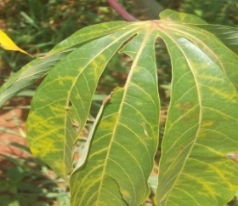
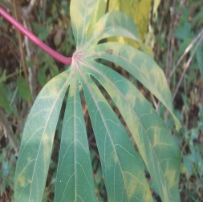
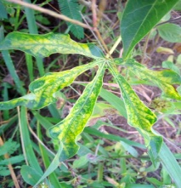
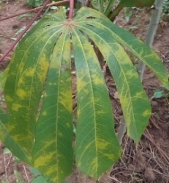
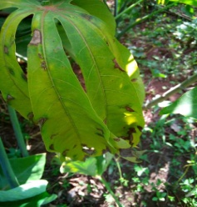
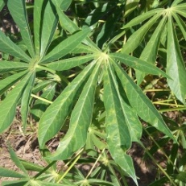
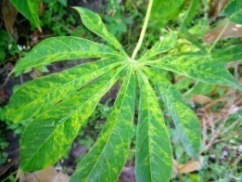
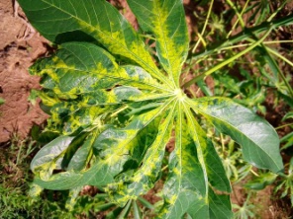
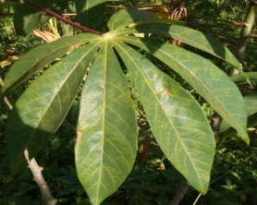
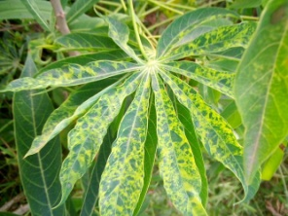
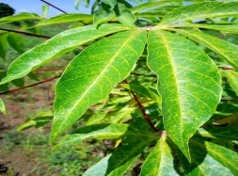
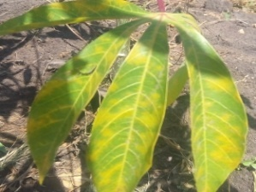
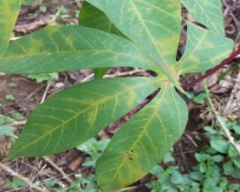
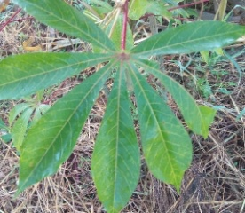
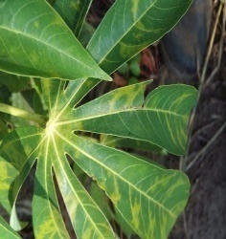
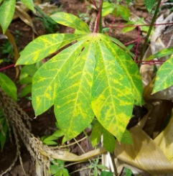




DATA SET

Slide 26
ACCURACY OF DETECTION
Name of Class | Samples | Recognized | Misclassified | Recognition rate(%)
Healthy leaves | 35 | 35 | 0 | 100
CBB | 35 | 34 | 1 | 97.14
Brown spot | 35 | 31 | 4 | 88.57
Mosaic | 35 | 33 | 2 | 94.28
<number>

Slide 27

OUTPUT
<number>

Slide 28

<number>

Slide 29
PROPOSED MODEL
Camera
Seed Dispenser
plougher
Soil covering tool
<number>

Slide 30


<number>

Slide 31
COST ANALYSIS
Sl.No | COMPONENTS | FIELD OF USE | NO.OF UNITS | COST PER UNIT
1 | 12 V Power supply | Robot Vehicle | 1 | 400
2 | Raspberry Pi 4 | Leaf Disease Detection | 1 | 4000
3 | Pi Camera | Leaf Disease Detection | 1 | 500
4 | 12 V DC Motor | Robot Vehicle Wheel & Plougher | 3 | 200
5 | 5V Servo Motor | Seed Dispenser | 1 | 125
6 | L293D IC | Robot Vehicle | 2 | 130
7 | Motor Chassis | Robot Vehicle | 1 | 200
8 | Wheels | Robot Vehicle | 4 | 40
9 | PCB | Circuit Designing | 1 | 500
10 | LED | Indication | 3 | 3
11 | Other |  |  | 500
Total |  |  |  | 7254
<number>

Slide 32
CONCLUSION
This project intent to reduce the requirement of large man power and cost of equipment making it is affordable to farmers
The agricultural robot is designed to facilitate the farmers to ease their work
Plant diseases cause major losses in terms of production ,economy, quality and quantity of agricultural products. So it is necessary to control the loss incurred by the plants.
Once the concept of automation in agriculture is accepted, the adoption rates will become high and the costs of technology will be low.
<number>

Slide 33
FUTURE SCOPE
The project can be implemented with enormous results on a large scale that benefits all farmers of the world .
Apart from ploughing, seed dispensing and water spraying other farming processes like spraying pesticides, harvesting .
In the future, the drip irrigation system can also supply agricultural chemicals like calcium, sodium, ammonium, zinc, fertilizers to the field .
<number>

Slide 34
REFERENCE
“ Autonomous Agri robot for smart farming” Ashish Lalwani , Mrunmai Bhide, and S. K. Shah
“Intelligent Autonomous Farming Robot with Plant Disease Detection using Image Processing”. A. Shaikh, Ghorale Akshay G, Chaudhari Prashant A, Kale Parmeshwar L. International Journal of Advanced Research in Computer and Communication Engineering Vol. 5, Issue 4, April 2016
Detection of plant disease using threshold, k-mean cluster and ANN algorithm”. Tete, T. N., & Kamlu, S. (2017). 2017 2nd International Conference for Convergence in Technologydoi:10.1109/i2ct.2017.8226184
“An overview of the research on plant leaves disease detection using image processing techniques.” Gavhale KR, Gawande U.IOSR Journal of Computer Engineering (IOSR- JCE). 2014Jan; 16(1):10-6.
Remote Area Plant disease detection using Image Processing S.Bashir, N.Sharma, IOSR Journal of Electronics and Communication Engineering , Volume 2, Issue 6 ,pp.31-34,2012.
https://www.kaggle.com/c/cassava-leaf-disease-classification
https://agritech.tnau.ac.in/crop_protection/crop_prot_crop%20diseases_veg_cassava.html
<number>

Slide 35
THANK YOU
<number>

